Slide 1
APS1052: Final Project: MSFT Stock Prediction William Ferrie - 1004241509 For explanatory notes please see Speaker Notes on each slide.

Slide 2
Project Overview
Background
Data Acquisition and Processing
Feature Engineering
Exploratory Data Analysis
Data Pipeline
Model Selection and Tuning
Testing
Evaluation and Conclusions
Notes:
This slide here is an overview of the overall presentation and project.

Slide 3
1.
Background
Project Goal

Slide 4

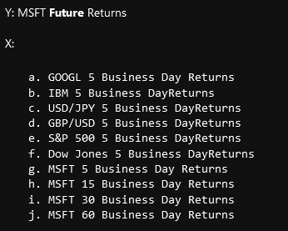
Background
Project goal to extend Tatsat’s Case Study 1: Stock Price Prediction found in Chapter 5: Supervised Learning: Regression
Target is MSFT stock returns
Notes:
The project I will be doing will be extending the Stock prediction model found in Tatsat’s book, Chapter 5: Supervised Learning: Regression, Case Study 1: Stock Price. In this case study, Tatsat’s target is the weekly (5 business day) future return of MSFT stock.
Tatsat uses limited indicators, in particular the 5 business day returns of GOOGL, IBM, USD/JPY ETF, GBP/USD ETF, SPY, DIA, as well as the 5, 15, 30, and 60 day returns on Microsoft stock.
Tatsat’s seed program can be found at this link: https://github.com/tatsath/fin-ml/blob/master/Chapter%205%20-%20Sup.%20Learning%20-%20Regression%20and%20Time%20Series%20models/Case%20Study%201%20-%20Stock%20Price%20Prediction/StockPricePrediction.ipynb
It can also be found in the book itself, and the link again at the end of this presentation

Slide 5
Background
Some Extensions and Modifications made:
Additional indicators included
Intra-day data used
Predicted target based on open price
Regression problem changed to multi-label classification
More in-depth model tuning with Pipeline and GridSearch
Better Evaluation Metrics
Notes:
The approach taken to the problem however is quite simple, and so I feel that I can expand on it. Some modifications that I have made are including many more indicators and designing / creating new features, using intra-day hourly data as opposed to weekly data, predicting based on the open price, changing it from a regression problem to a multi-label classification problem, providing more in depth model tuning using pipelines and gridsearch, and finally, performing more in depth evaluation of the model, instead of just basic statistical evaluations.

Slide 6
2.
Data Acquisition
And Data Processing

Slide 7










Data Acquisition
Data pulled from WRDS and from Indicators provided on Quercus
All data created to be hourly from 4am to 8pm on every business day in 2017
Millisecond data converted to hourly data via the scripts provided on Quercus.
Notes:
For the indicators, I used the same ones as Tatsat: MSFT (stock), IBM (stock), GOOG (stock), FXY (ETF), FXB (ETF), SPY (ETF), DIA (ETF), VIXY (ETF), as well as some additional ones: AAPL (stock), AMZN (stock), NVDA (stock), FB (stock), INTC (stock), CRM (stock), SAP (stock), ORCL (stock), FXE (ETF), MSFT put/call ratios and parity, SPY put/call ratios and parity, SPY DIX and GEX (ETFs), and VIX Contango Backwardation (vix3m/vix).
The stocks were chosen as companies that work alongside Microsoft, or are Microsoft competitors.
For Put/Call Ratio and Parity, DIX, GEX, and Contango Backwardation, I used daily data.
For all others I pulled millisecond data from WRDS and processed it into hourly data. I recognize that it is not ideal to mix these indicators of different frequencies however I was unable to obtain intra-day data for the options data, DIX, GEX, and Contango backwardation, so this will just be a limitation of the model / source of error.
WRDS data acquired from (https://wrds-www.wharton.upenn.edu/pages/get-data/nyse-trade-and-quote/millisecond-trade-and-quote-daily-product-2003-present-updated-daily/consolidated-trades/)
Data for the year 2017 was used, as WRDS only allows for millisecond resolution data queries of up to 1 year, and 2017 did not appear to have any major stock market crashes.
The millisecond data was processed into hourly data using the provided hourly processing scrips provided on Quercus

Slide 8
3.
Feature Engineering
Creating Additional Indicators
Notes:
Now we will talk about the indicators used, and the feature engineering process to create additional indicators.

Slide 9
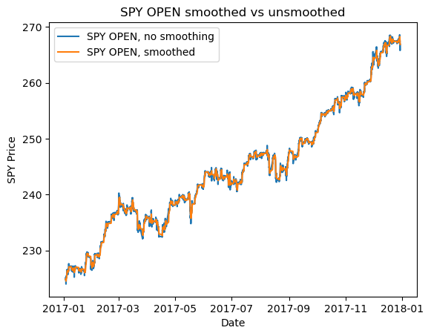
Feature Engineering
Hourly returns of 4, 8, 16, 32 hours of the OPEN price created
TALib features generated
TALib timeperiod / window optimized in data pipeline
Exponential Weighted Moving Average performed on OPEN
Wavelet smoothing performed on Returns
Notes:
For the aforementioned stocks and ETFs, the hourly OPEN (price), CLOSE (price), HIGH (price), LOW (price), and VOL(quantity) were used. Additionally, percentage returns for 4 hours, 8 hours, 16 hours, and 32 hours were created. No additional feature/indicator engineering was done on the options parity and ratios, or on the vix3m/vix (vix contango backwardation). However for this daily data, a fill forward was used after merging all of the data into one dataframe. Again, this creates repeated data which is not ideal, but I felt it would lead to a better result than imputing with a mean or 0.
All trading was done on the OPEN, so the HIGH, LOW, CLOSE, and VOL features were all shifted by 1.
Next, the TALib features were created in python for each stock and ETF, in particular, the RSI, SMA, Corr, SAR, ADX, OO, and OC features. The window for the talib features was initially set to 10 however it is optimized in the pipeline (to be discussed later).
For the OPEN prices, I performed smoothing using the built-in pandas exponential weighted moving average. I did so to preserve the trend of the OPEN.
Further smoothing on the returns features will be done using wavelets prior to the Pipeline, however that will be discussed later.

Slide 10
Feature Engineering - Target
Four hour future returns calculated via pandas pct change and then shifted four periods
Regression target then ordinally encoded where bottom 33% returns become -1, 34% to 66% become 0, and 67% upwards become 1
Label | Count
-1 | 1448
1 | 1448
0 | 1362
Notes:
As mentioned before, the target is the future four hour returns on MSFT stock. To turn this into a classification problem, I encoded the returns using a three label ordinal system. I could have used a two label system, (positive or negative) however as we saw before in the homework, three labels leads to better results. The label counts themselves are pretty balanced, with -1 and 1 having equal counts and 0 having only about 80 less.

Slide 11
4.
Exploratory Data Analysis

Slide 12
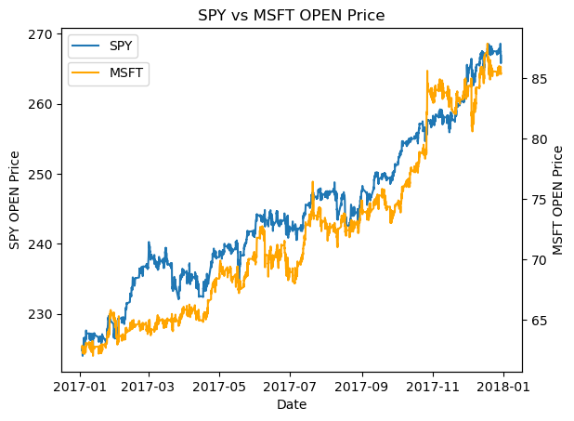
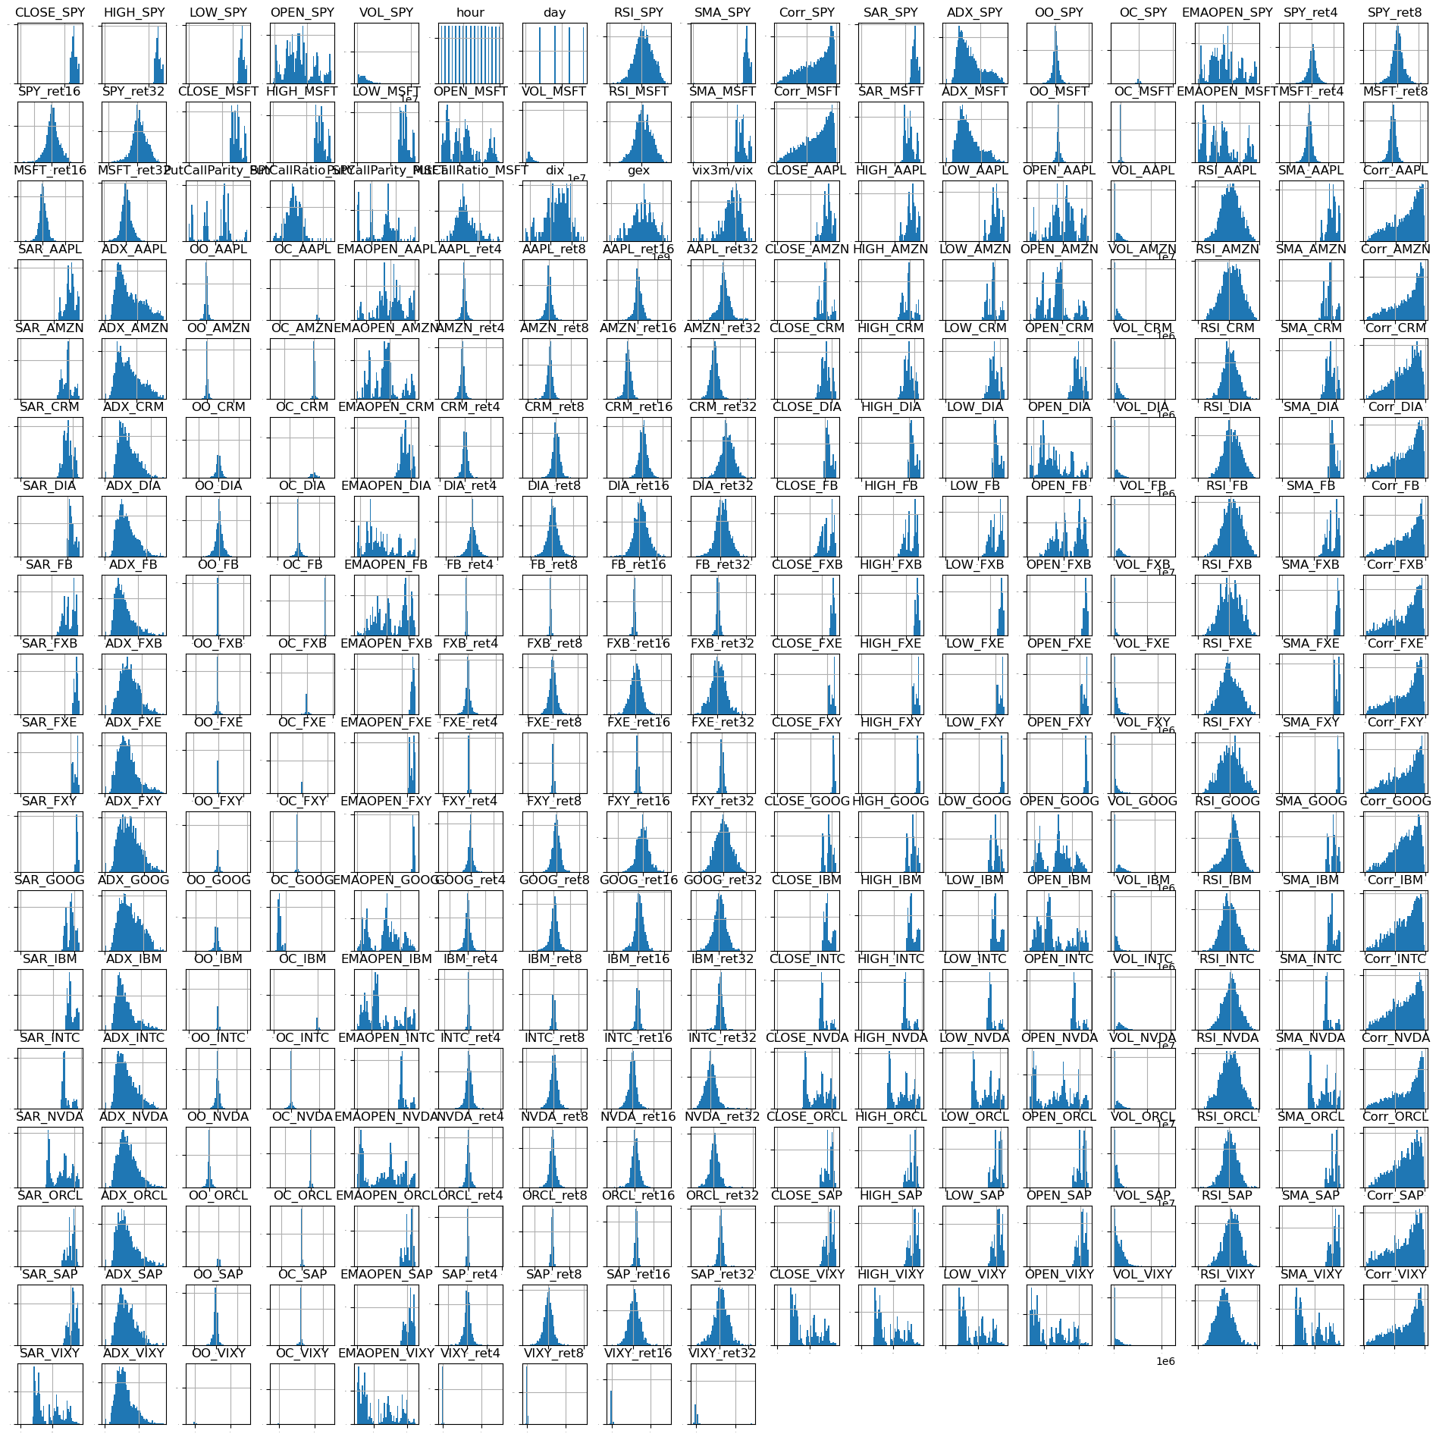
Exploratory Data Analysis
Next, I created a few plots just to get a sense of the data.
In particular, I was interested in how MSFT moved relative to SPY, and how each feature was distributed.
Note the distributions on the right are impossible to show in detail on these slides. Please see notebook for detailed view.
Notes:
Performing exploratory data analysis is a good practice, to better understand the data, and its limitations. For this project, I was particularly interested in how MSFT moved relative to the whole market (approximated as SPY), and how each feature was distributed.
Overall MSFT tended to move with the market although was far from perfectly correlated (as expected).
The distributions of many features were seemingly random, however the returns seemed to be relatively close to normal distributions which was interesting.

Slide 13
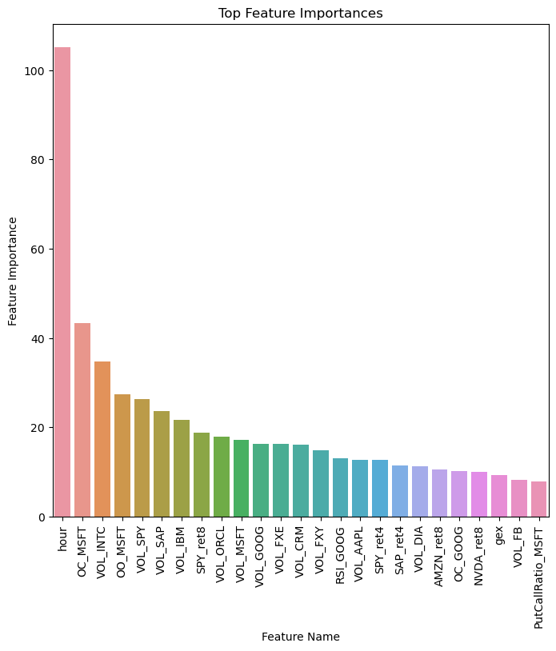
Exploratory Data Analysis - Features
Feature Importances generated just for visualization purposes
Generated using SelectKBest with arbitrary k = 25
Actual feature selection will be done in pipeline
TALib features, Volume Features, and hour of day important
Notes:
Next I was interested in what features were most important to the output. I took a look by using sklearn’s SelectKBest. I chose to look at the top 25 features arbitrarily, as this isn’t going to have an effect on the final program, it is just for visualization purposes. The actual feature selection is done in the pipeline using SelectPercentile.
What surprised me the most is that the hour of day had a big effect on the future returns. Also the volume of the trade in a given hour were more significant than I thought, however I suppose this makes sense as large volumes of trades can result in large price changes.

Slide 14
5.
Data Pipeline
And Data Processing

Slide 15
Data Pipeline - Original
Data Pipeline created to ease of training models and tuning hyperparameters
Wavelets originally part of pipeline to smooth percent return features
Data
Wavelet Smoothing*
TALib Optimizer
Scaler
Selector
Classifier
Model Results
Notes:
To facilitate better and more robust model training, I created a data Pipeline. The pipeline performs optimization on the TALib window parameter, scales the inputs using sklearn’s StandardScaler(), selects the most important features using sklearn’s SelectPercentile with a scoring function of f_classif, and finally passes the data to a classifier.
Initially, I had intended to have the wavelet smoothing in the pipeline, however it began causing numerous issues. Although not ideal, due to the time constraints of this project I opted to move it outside of the pipeline, and perform wavelet smoothing on the data before then passing it into the pipeline. This is a less elegant, and less robust solution, and doesn’t allow for me to tune the wavelet scale as part of the pipeline gridsearch, however it will have to suffice.
The wavelet smoothing was performed on the return features, as they are approximately normally distributed and don’t follow a trend. This will denoise the returns data and allow for better prediction by the model.

Slide 16
Data Pipeline - After
Data Pipeline created to ease of training models and tuning hyperparameters
Smoothing, Feature Optimization, Feature Scaling, Feature Selection, and Classification all part of pipeline
Smoothed Data
TALib Optimizer
Scaler
Selector
Classifier
Model Results
Notes:
Next, the TALib optimizer allows for us to tune the window parameter used when creating the TALib features, resulting in better features for the model.
The scaler scales each feature to 0 mean and 1 variance. This does not have an effect on the result, but does allow for better numerical stability and better convergence.
I opted to use a selector as at this point we have almost 300 features, many of which I suspect are not all that helpful. I used SelectPercentile with a variable percentile (tuned during gridsearch), and used f_classif for the score function. The reason I went with this and not something like PCA, is because this is a supervised machine learning problem, f_classif is fast, and this will result in the removal of many less useful features.
Finally, the data is passed on to the classifier which is trained using 5 fold cross validation. As this is time series data, this cross validation is done via TimeSeriesSplit so that time ordering is preserved.

Slide 17
6.
Model Selection
And Tuning

Slide 18
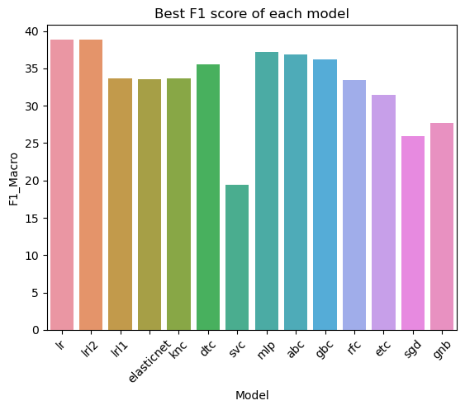
Model Selection and Tuning
Fourteen Classifiers created for training in the pipeline
Potential models evaluated on F1 score
Non-regularized Logistic Regression and MLPClassifier proceed to next stage
All tuning done via GridSearchCV
Notes:
After creating the pipeline, twelve classifiers were created to be tested. Each classifier corresponds to a regressor used in Tatsat’s seed program. However, Tatsat also uses an LSTM and ARIMA model. These models however are regressors and therefore not fit for our application. To make up for this, I replaced these with SGDClassifier (stochastic gradient descent classifier), and GaussianNB (Gaussian naïve bayes) , to bring the total number of classifiers tested up to fourteen.
To evaluate the performance of the models, I used f1_macro as it lends itself to classification problems, is a holistic metric, and most importantly, it is fast. In earlier iterations of my code I had tried using Phi K as a scorer however it was extremely slow.
From the models tested, logistic regression (as well as l2 regularized logistic regression), and the MLPClassifier performed the best, so I tuned them further,

Slide 19
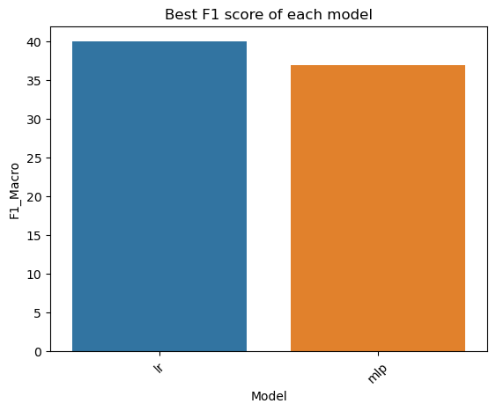
Model Selection and Tuning
Logistic Regression still outperformed MLPClassifier after further hyperparameter tuning
Logistic Regression better score however proceeding with MLPClassifier
Notes:
After performing further hyperparameter tuning on Logistic Regression and the MLPClassifier, Logistic Regression was still the best.
Initially, I proceeded with Logistic Regression however got very unsatisfactory results, and I suspect it was overfitting. I went back and instead proceeded with the MLPClassifier and it did far better, so despite the small difference in F1 scores, I am going to proceed with the MLPClassifier for evaluation on the test set.

Slide 20
7.
Testing
Evaluating on the Test Set

Slide 21
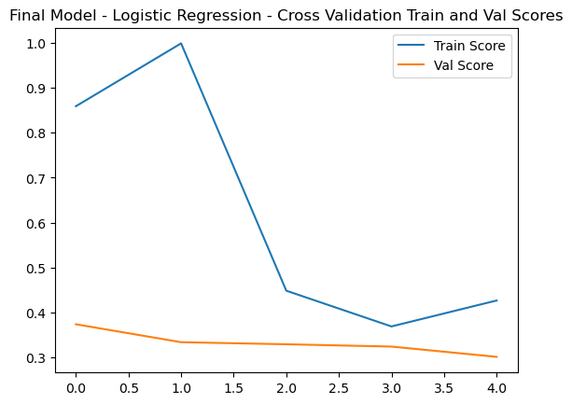
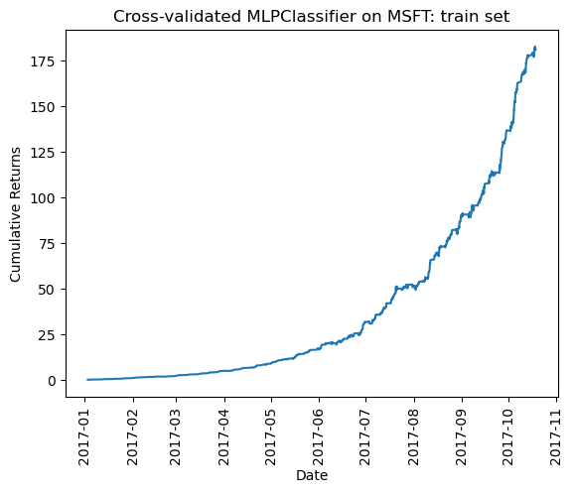
Testing
Final Logistic Regression Model trained and Cross Validation scores plotted
Cumulative Returns from model based on trading right after the open appear promising on the training set.
Notes:
Now I tested the final MLPClassifier model on the test set to see how it performs.
First, I plotted the training and validation scores from the pipeline’s cross validation (for the optimal hyperparameters). This is only for 5 fold cross validation so it is not a very high resolution plot.
After calculating the cumulative returns using the process from the homeworks, assuming trading right after the open (as has been the assumption throughout this notebook), the resulting curve looks very promising, being up almost 180% in only 11 months! This is too good to be true though, and is because this is training data, so obviously it is going to do well. The real evaluation will come with the test set.

Slide 22
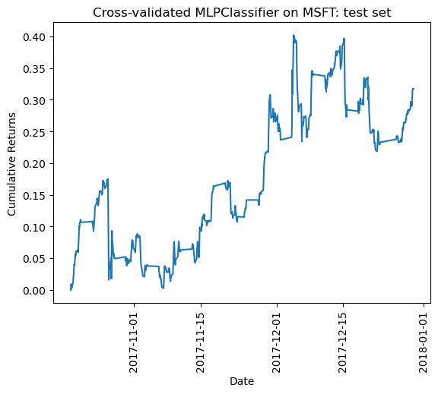
Testing
On the test set, model performs well with approx. 0.3% returns in one month
These are low but returns are cumulative, so extrapolated over 12 months would be higher
Notes:
Overall the model performs relatively well, achieving approx. 0.3% cumulative returns after 1 month. However these are cumulative returns, so if this trend were to continue over the course of a year, it could do fairly well.
Note however that the returns on the test set are fairly noisy, so it is very possible that this trend does not continue into the future. Unfortunately my data is limited to only 2017, however with more data this could be investigated further.

Slide 23
8.
Evaluation
And Conclusions

Slide 24
Evaluation –Statistical Metrics
Accuracy | 0.406
F1 | 0.340
Precision | 0.409
Recall | 0.395
Notes:
For our statistical metrics, the model overall does poor to moderate. On all metrics it is below 0.5, and as a result is not that great.
However, this is not a purely statistical model, so financial metrics may be a better way of evaluating this.

Slide 25
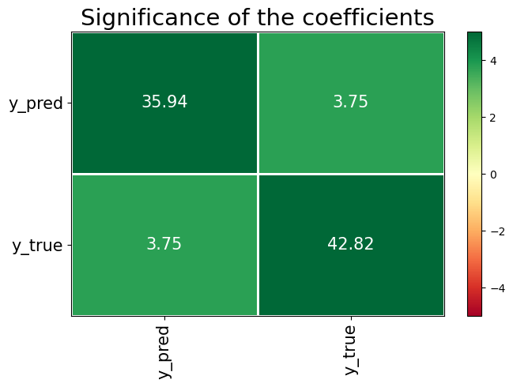
Evaluation – Phi K
Phi K Corr | 0.317
Phi K p-val | 9.956
Notes:
First we take a look at our Phi K values
The significance plot of the coefficients looks promising, however, the correlation and p value tell a different story.
The correlation is 0.317 which given that it is a value between 0 and 1, isn’t great. However, it is ultimately meaningless when we look at the p value
The p value is 9.956 – far above <0.05 for which we would need in order to accept this as statistically significant. As a result, the Phi K does not tell us much about the model.

Slide 26
Evaluation – Other Financial Metrics
Out of Sample CAGR | 0.085
Sharpe Ratio | 0.897
maxDD | -0.147
maxDDD | 364
Calmar Ratio | 0.577
Notes:
Our results are pretty good. These are all calculated using modified code from the course homework
The out of sample Compound Annual Growth Rate (CAGR) is 0.085 or 8.5%. This is greater than 0, and so I am satisfied with it.
The Sharpe Ratio, the measure of the risk-adjusted performance of a portfolio, isn’t that great, and is less than 1 at only 0.897.
The max drawdown (maxDD) was -0.147
The max drawdown duration (maxDDD) was 364. As our periods are hours, this corresponds to about 23 days of drawdown before it was able to bounce back up
The Calmar Ratio is >0.5 and so it is just barely good. Ideally we would have a Calmar ratio of >3, so this is disappointing.

Slide 27
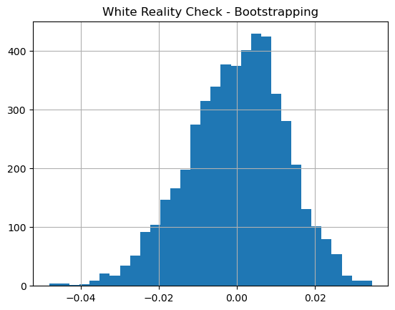
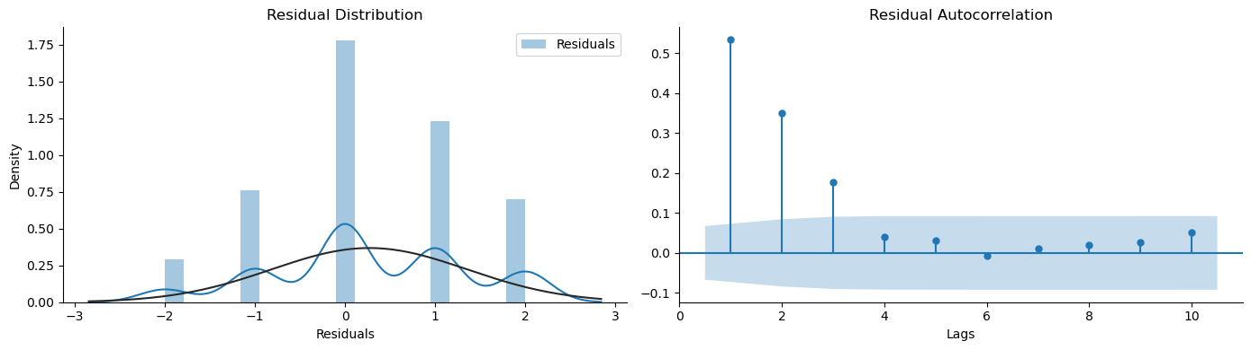
Evaluation – Other Metrics
Ljung-Box Test p-val | ~0
White Reality Check Avg Return | -0.027
White Reality Check p-val | 0.973
Notes:
First of all, our Ljung Box Test has a p value of almost 0. Since its is <0.05, we can determine that the autocorrelations are different from 0 and therefore are statistically significant.
The White’s Reality Check, gives us a disappointing result. The average return found after bootstrapping was -0.027, which even though it is close to 0, is still negative. The most disappointing result is that the p-value is >0.05, meaning that the results we have are no statistically significant, and could be due to data snooping. To get around this we would need to take a new approach to the project and reassess which data we are using, which models we are using, and how the pipeline is set up. Unfortunately, there is just not time for that. Instead we will have to just accept these disappointing results and look at the limitations of the model, and how it could be improved in the future.
This result intuitively is however not surprising. If it were this easy to predict a stock’s future price, we would all be millionaires.

Slide 28
Model Conclusions and Limitations
Overall a good experience
Results promising but not statistically significant
Model limitations identified throughout creation
Difference in Data Frequency between some features
Only 1 year of data
Wavelet scaling done before pipeline
Models not that sophisticated
Notes:
To conclude, the model definitely needs some work. Although the results seemed promising at first, and perhaps evaluated against some crude statistical metrics looked good, after looking at it from more refined financial metrics we see that our results are not statistically significant, and the positive returns are just due to chance.
Despite this, the project was still a great learning experience and provided a great opportunity to implement course concepts into a full end-to-end project.
There are definitely some limitations of the model that could be improved upon. For example, the options indicators, DIX, GEX, and VIX Contango are all of daily frequency while the stock and etf features are of hourly frequency. Mixing frequencies of data is not great due to many repeated values and therefore could be having a negative effect.
Additionally, I only pulled 1 year of data from WRDS (2017 to be specific). Perhaps if I had included multiple years it could have had a better effect as there would be more training data.
As mentioned before, the wavelet smoothing was done on the returns features prior to the pipeline. This was less than ideal, and had I been able to properly implement it in the pipeline, I could have tuned its scale as a hyperparameter. This could have led to better smoothing of inputs and therefore better features, and therefore better models.
Finally, the models used are just not that sophisticated. Compared to what is possible with deep learning, the sklearn machine learning models I used in this were in hindsight probably too simple. With more time, it would perhaps have been better to focus on implementing a deep learning model with Keras-TensorFlow.

Slide 29
THE END Thank You
Notes:
Thank you for taking the time to read my presentation

Slide 30
Attributions
Seed program courtesy of Tatsat available here
Stock and ETF intra-day data acquired from WRDS, available here
DIX, GEX, VIX Contango, Options data acquired courtesy of APS1052 teaching team, available on Quercus
Intra-day Processing Data Scripts courtesy of APS1052 teaching team, available on Quercus
Model Evaluation (especially financial metrics) adapted from APS1052 Homework, available on Quercus
Notes:
Please see attributions on the slide above

